Slide 1
Secure Data Hiding in Image Using Steganography
CAPSTONE PROJECT
Presented By : Mogamatam Ramyasri
Student Name : Mogamatam Ramyasri
College Name : Chalapathi institute of engineering and technology
Department : Information Technology and Cybersecurity

Slide 2
OUTLINE
Problem Statement
Technology used
Wow factor
End users
Result
Conclusion
Git-hub Link
Future scope

Slide 3
Problem Statement
This project implements steganography allowing users to hide secret messages within images using pixel manipulation.
A passcode-based encoding mechanism ensures an extra layer of security.
The tool can be used for secure communication and data protection while maintaining the visual integrity of the image.
The approach maintains image quality while providing a simple yet effective encryption mechanism for confidential data sharing.

Slide 4
Technology used
Technologies Used :
Image Processing & Steganography
Python Programming
Libraries & Platforms:
Libraries:
cv2 (OpenCV) – For image processing and manipulation
OS – For file handling and system operations
string – For character encoding
Platform: Windows (Can be adapted for Linux/macOS)
IDE Used: IDLE Python

Slide 5
Wow factors
Image-Based Steganography: The project securely hides secret messages within images without visibly altering them, ensuring undetectable data embedding.
Passcode-Protected Encoding: Unlike basic steganography methods, this project includes a passcode mechanism, adding an extra layer of security for message retrieval.
Lightweight & Efficient: The implementation is simple yet effective, requiring minimal computational resources while maintaining image quality.
Cross-Platform Compatibility: Though designed for Windows (IDLE Python), the project can be adapted for Linux/macOS with minor modifications.
User-Friendly Implementation: The project uses a straightforward Python script that allows users to easily encrypt and decrypt messages with minimal setup.

Slide 6
End users
Cybersecurity Professionals – Can use this technique for secure communication and covert data transmission.
Journalists & Whistleblowers – Helps in safely sharing sensitive information without detection.
Government & Defense Agencies – Useful for confidential data exchange and secure intelligence sharing.
Researchers & Academicians – Beneficial for studying and improving data-hiding techniques in digital forensics and cryptography.
General Users & Privacy Enthusiasts – Individuals who want to protect personal or confidential messages from unauthorized access.

Slide 7
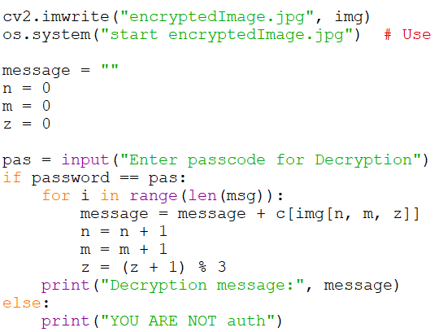
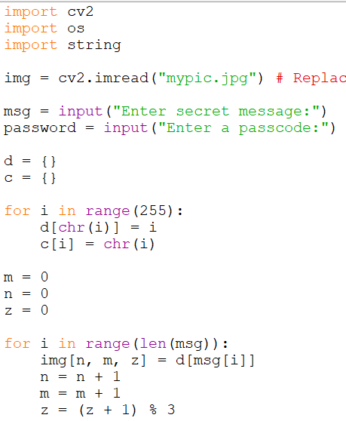


Results
Decryption Code:
:
Encryption code:
Input Image:
Output Image:

Slide 8
Conclusion
This project successfully implements image-based steganography, allowing users to securely hide and retrieve secret messages within images while maintaining their visual integrity.
The integration of passcode protection enhances security, ensuring that only authorized users can decode the hidden information.
The project demonstrates an efficient, lightweight, and user-friendly approach to secure communication, making it suitable for cybersecurity, data protection, and covert information exchange.
Future improvements could include enhanced encryption techniques and support for multiple image formats, further strengthening the system’s robustness and usability.

Slide 9
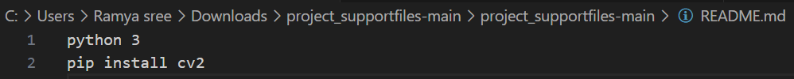
GitHub Link
https://github.com/RAMYASREE162004/project_supportfiles.git
Readme File:

Slide 10
Advanced Encryption Techniques – Integrating stronger encryption methods to enhance data security.
Support for Multiple Image Formats – Expanding compatibility beyond standard image types.
Increased Data Capacity – Optimizing storage techniques to embed larger messages.
GUI Implementation – Developing a user-friendly interface for easier access.
Mobile & Web Integration – Extending functionality to mobile and web applications for wider accessibility.
Future scope(optional)

Slide 11
THANK YOU

